Slide 1
INTRODUCTION TO GOVERNMENT
What is government?

Slide 2
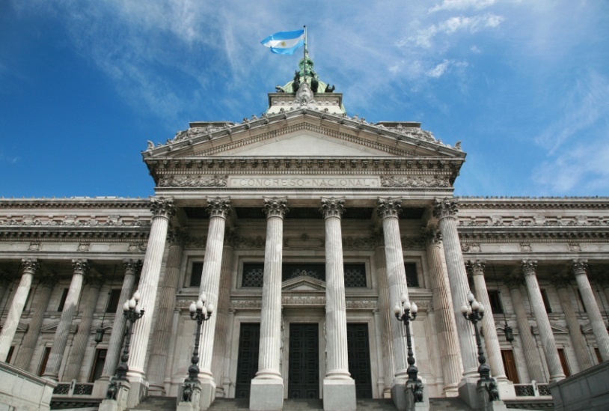
Government is the institution through which society makes and enforces its public policies.

Slide 3
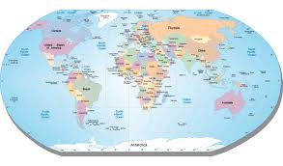
The “state” is the dominant political unit in the world.
A state is defined as a body of people living in a defined territory, organized politically (under a government) and having the power to make and enforce law without the consent of any higher authority.

Slide 4
Characteristics of a state:
1. Population
2. Territory
3. Sovereignty (supreme and absolute power)
4. Government (politically organized)

Slide 5
Four theories of the origins of the state…..

Slide 6
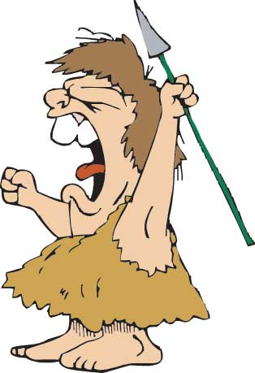
Evolutionary Theory

Slide 7
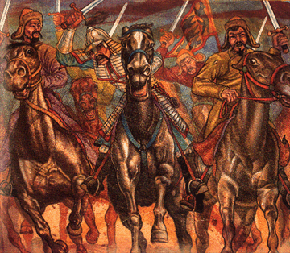
The Force Theory

Slide 8
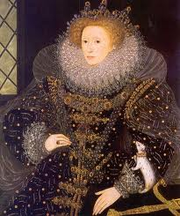
The Divine Right Theory

Slide 9
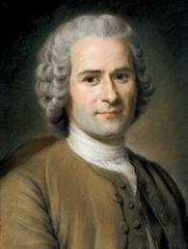
The Social Contract Theory

